Slide 1
Software Development Security
Sonika Verma
CSCD92: Week 08

Slide 2
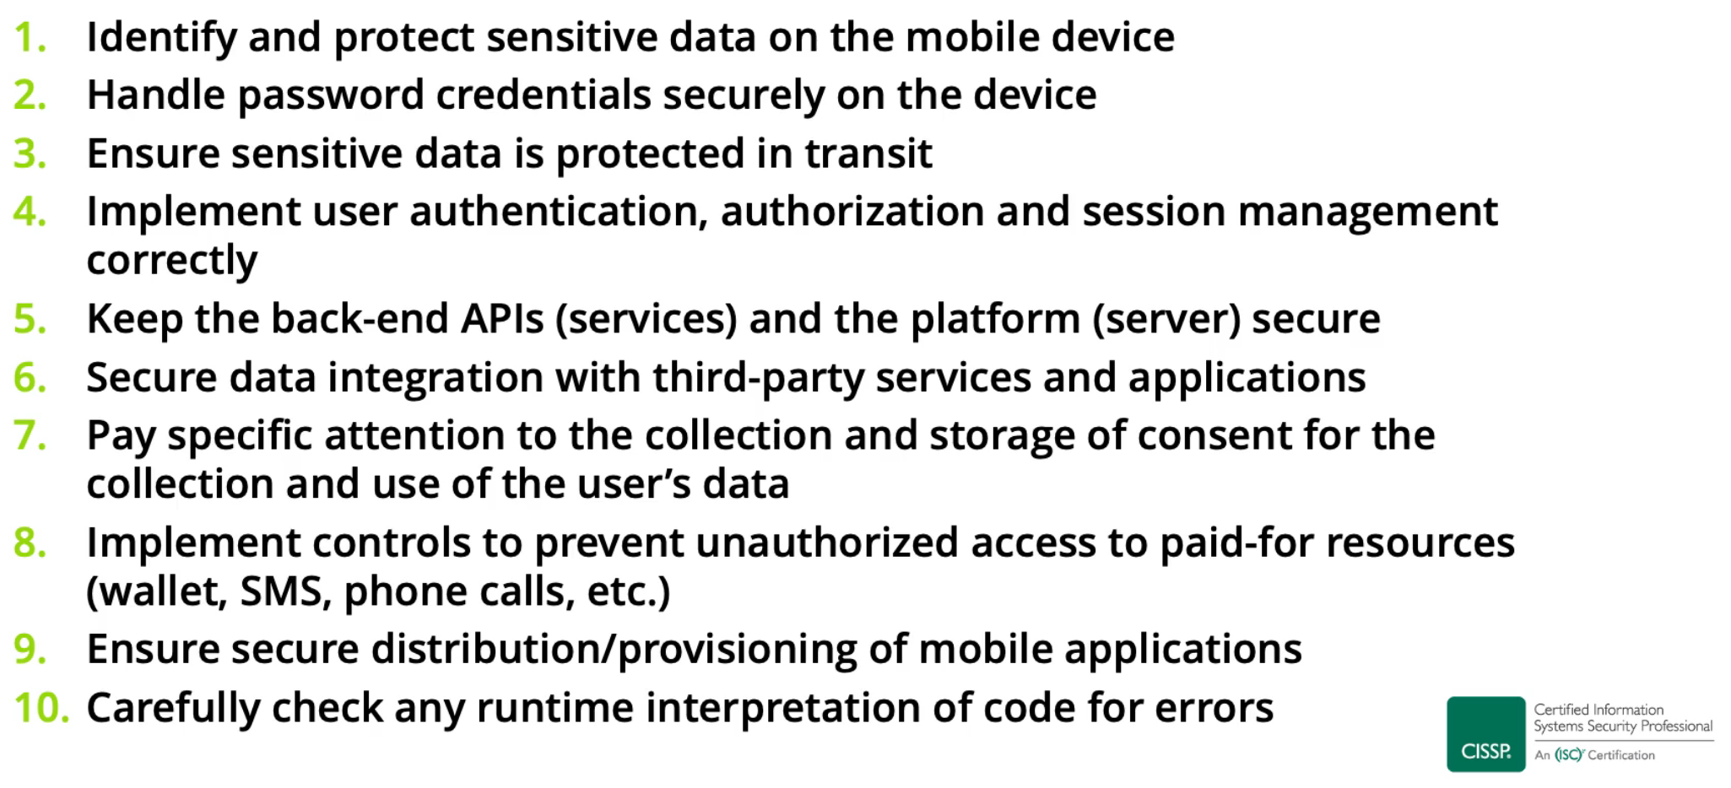
Unsecure Software Systems
Threat modeling & threat surface
Mobile code
Software environment + security practices
Common software design and coding errors

Slide 3
Unsecure Source Code
Source code, executable code, intermediate code, arbitrary code
Processes & management
Programming languages
Functional programming, object-oriented programming
Common object request broker architecture (CORBA)
Malformed input attacks
Buffer overflows, SQL injections, cross-site scripting
Covert channels
Memory leaks
Time of check vs. Time of use (TOC/TOU)
Trapdoors

Slide 4
Unsecure Databases
Aggregations and inference
Bypass attacks, query attacks
Compromising database
Exploiting access routes, intercepting data, web-based interfaces
Data contamination
Deadlocking
Denial of service
Physical / direct logical access

Slide 5
Unsecure Databases Protections
Database management systems
Data warehouses, data lakes, data farms
Database model
Transaction persistence, fault tolerance and recovery, sharing by multiple users, security controls, atomicity
Database management models
Hierarchal, network, relational, non-relational
Markup languages
Open database connectivity
Object linking and embedding
Metadata
Data mining
Knowledge management

Slide 6
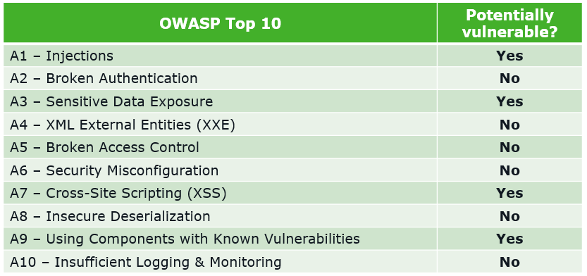
Unsecure Websites
Web application environments
Common attack patterns and security practices
OWASP Top Ten [Open Web Application Security Project]

Slide 7
Malware and Ransomware
Malware
Ransomware
Virus: file infectors, boot sector infectors, companion virus, email virus, macro virus, script virus
Worms, hoxes, trojans, remote access trojans, DDoS Zombies, logic bombs, spyware, adware, botnets
Protections
Scanners, heuristic scanners, activity monitors, change detection, zero day exploits and reputation monitoring
Anti-malware policies, intrusion detection and intrusion prevention, end point detection and response, software whitelisting, managed security services

Slide 8
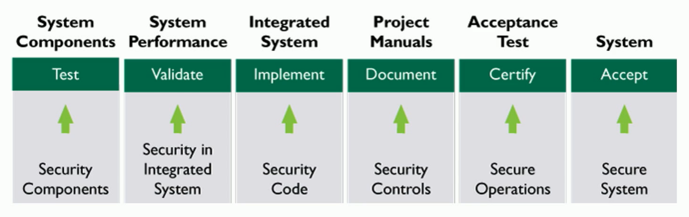
Security Development Management
Software development lifecycle(s)
Integrated product and process development
Development methodologies
Reuse, spiral, prototyping, clean room, extreme programming, agile, DevOps, DevSecOps
Secure coding guidelines
Source code analysis
Static, dynamic, interactive, runtime application security testing

Slide 9
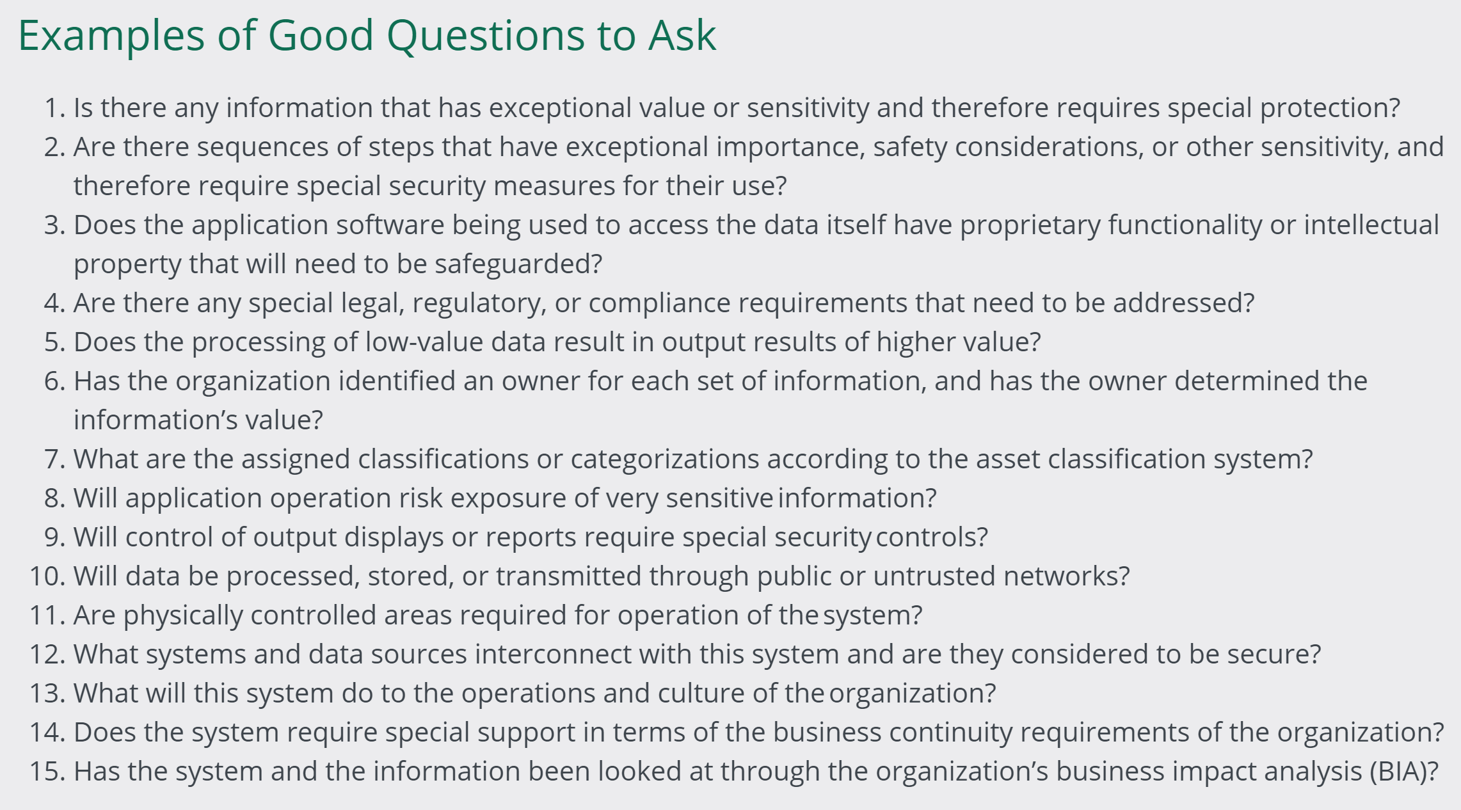
Security Development Management

